Slide 1
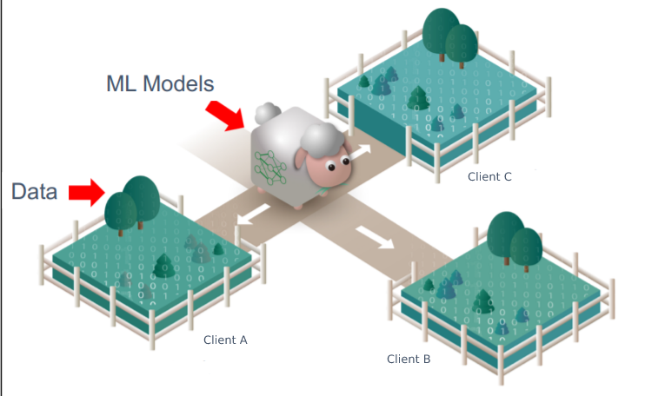
Federated Learning
Team Members
Aaditya Mani Subedi (075BCT001)
Arpan Pokharel (075BCT015)
Saugat Kafley (075BCT099)

Slide 2
Background
1
The emergence of the need of Data Privacy

Slide 3
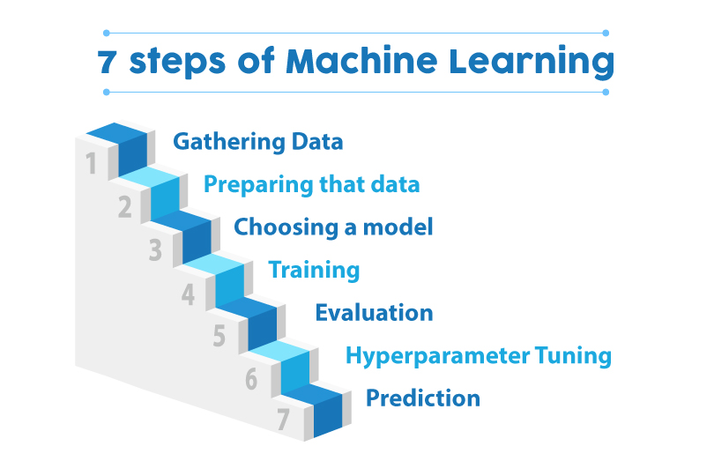
Contemporary Machine learning approach

Slide 4
Background
Increasingly strict laws on Data Security and Data Protection.
Growing concern on user privacy and data security
Data exist in the form of isolated point in a system where data is kept and segregated from other parts of the architecture.

Slide 5
Data sharing among parties :
Difficult, illegal or even Immoral
Sensitive data between corporations cannot be sent directly such as
Medical reports data,
Research materials
We need more control over data privacy and security
Corporate Security and Confidentiality Concerns
Data privacy concerns

Slide 6

Data sharing among parties :
Difficult, illegal or even Immoral
Data Privacy tampering.

Slide 7
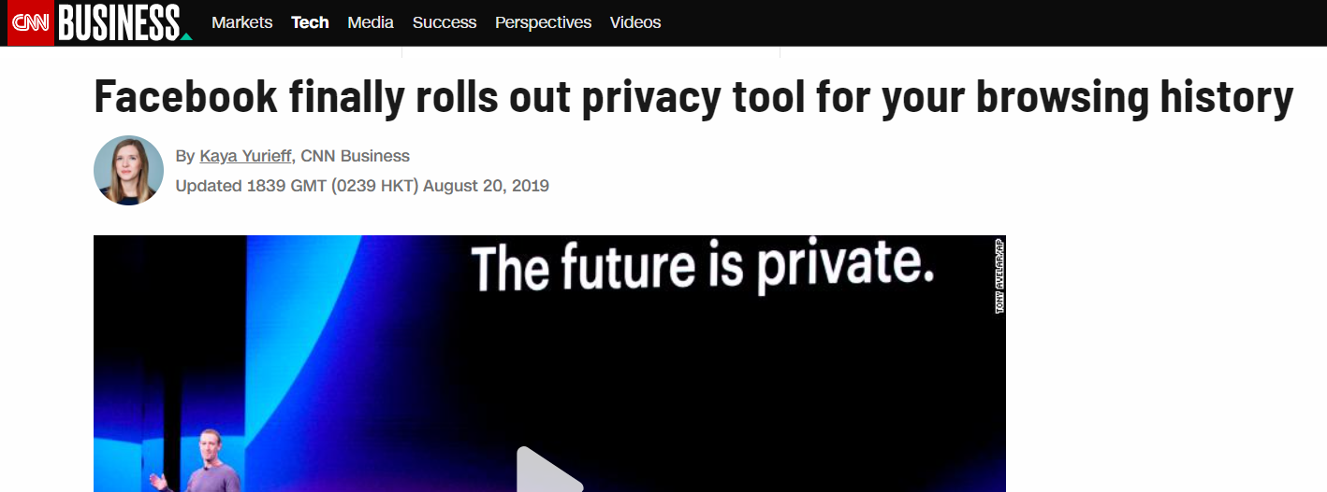

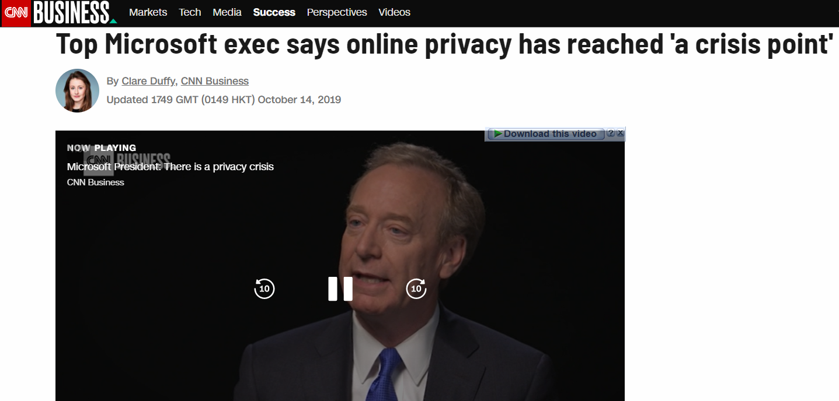
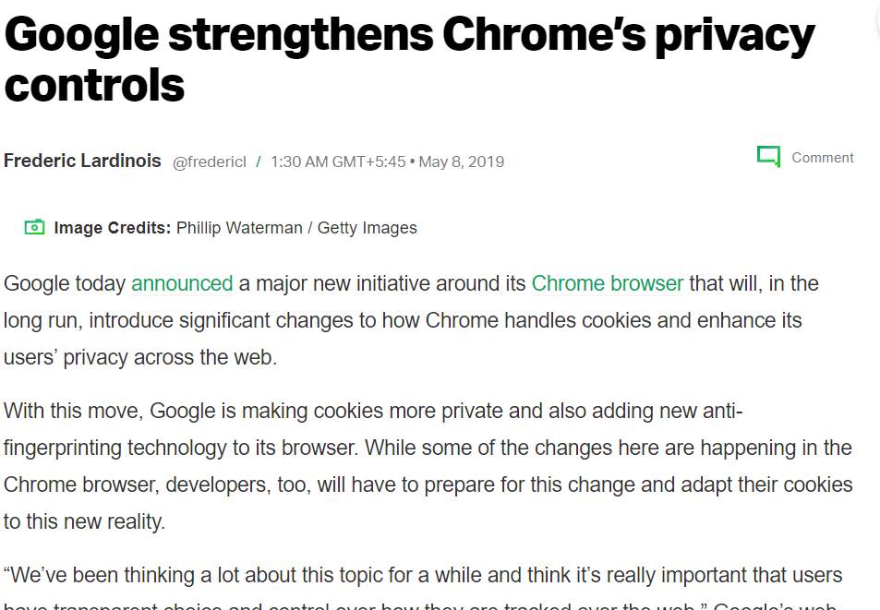
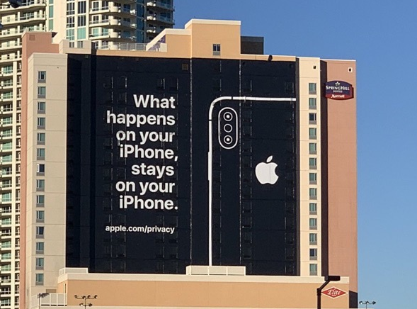
Movement for Data Protection

Slide 8

Challenges for prevailing AI
Data is present in isolated forms and fragmented.
Non-iid (Independent and identically distributed)
Unbalanced data
Data can be malicious and outdated.

Slide 9
Federated Learning
2
A Potential solution!

Slide 10
Let’s take a Simple Example.
Our Interpretation
Model == sheep
Data == grass
Originally, one need to purchase grass from different sources to feed sheep
Companies gather lots of data to train models,
where many challenges exist, such as user privacy, data security and regulations.

Slide 11
Let’s take a Simple Example.
Federated Learning provides an alternative:
Sheeps are led to different farms and can thus eat grass from all places without having to move the grass. ---
Federated learning models gather knowledge from various sources of data without having to observe

Slide 12
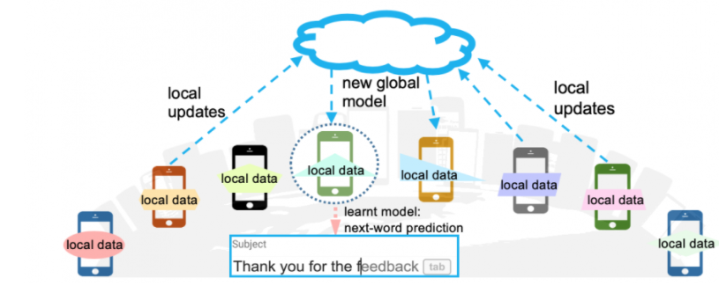
Federated Learning
Definition:
Multiple parties, each of which owns some data, collaborate to jointly train a machine learning model.
During training, no data held by each party will leave that party
Only the trained (results) are transferred not the *data
The performance of the resulting model should be a good approximation of the ideal model, built with all data transferred to a single party

Slide 13
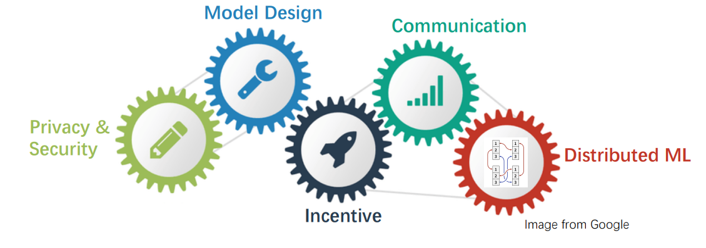
Processes involved in FL
Model Design and hyperparameter tuning. e.g CNN architecture.
Distributed learning algorithm, e.g. Client selection, tackling non-IID.
Communication optimization, e.g. alleviating the influence of network delay, model/gradient compression.
Security and privacy, e.g. Homomorphic Encryption (HE), Differential Privacy (DP).
Incentive mechanism, e.g. motivating organizations from different industries.

Slide 14
How does Federated Learning Work?
3

Slide 15
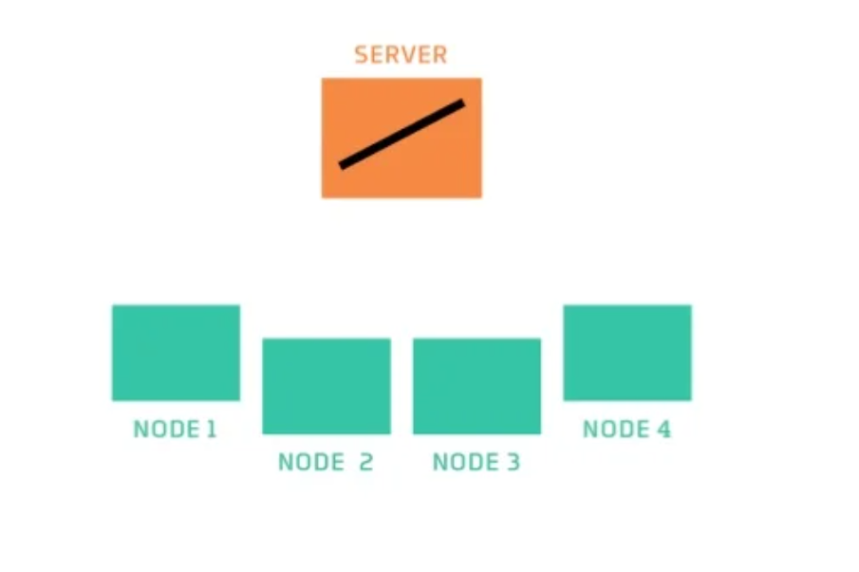
How Federated Learning works?
The server has untrained model.

Slide 16
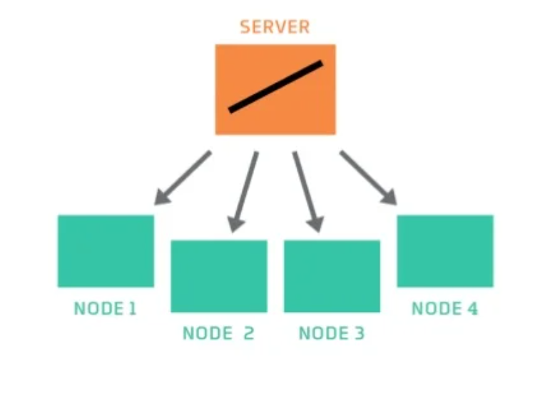
How Federated Learning works?
The server sends a copy of model to Nodes.

Slide 17
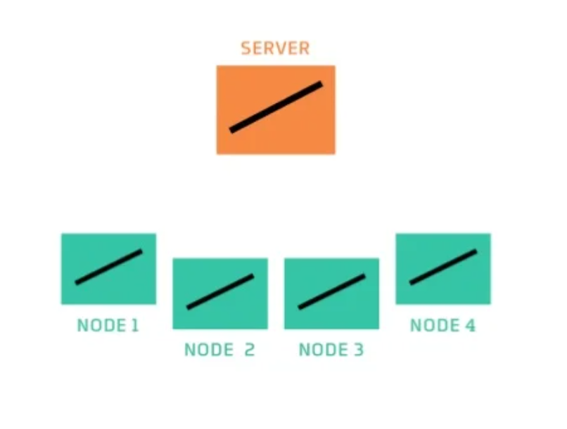
How Federated Learning works?
The Nodes now also have untrained model.

Slide 18
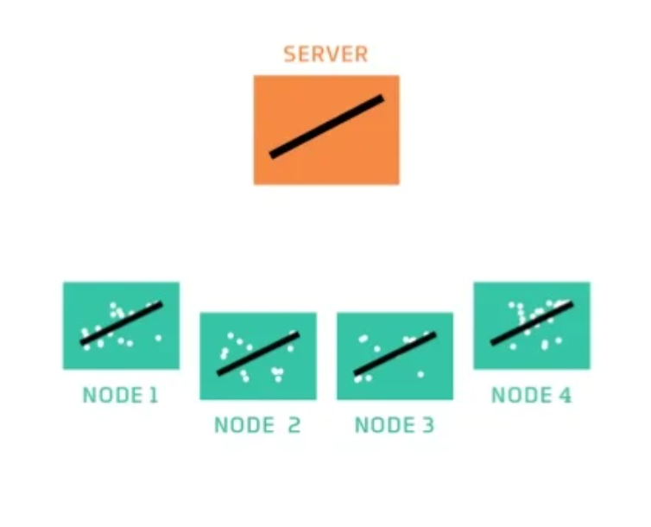
How Federated Learning works?
The Nodes have data to train their model.

Slide 19
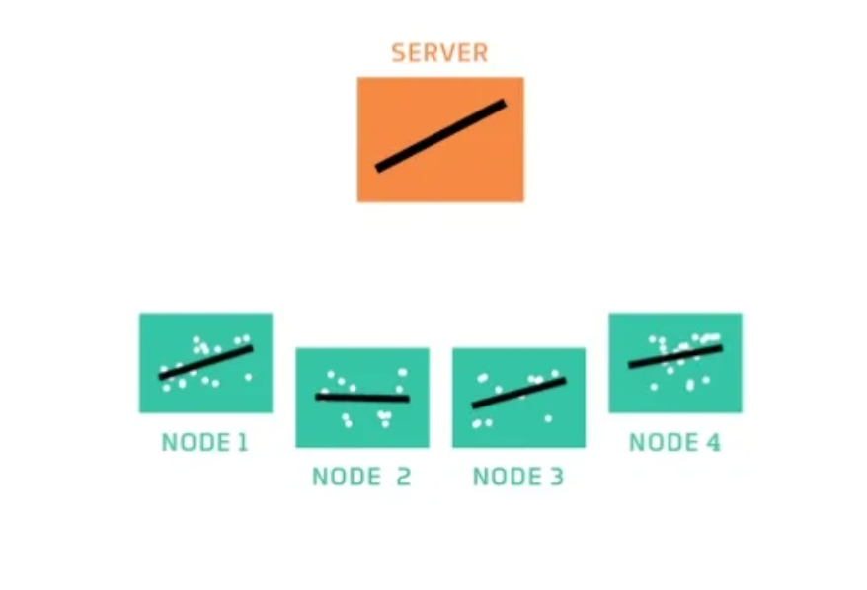
How Federated Learning works?
The Node trains and fits data .

Slide 20
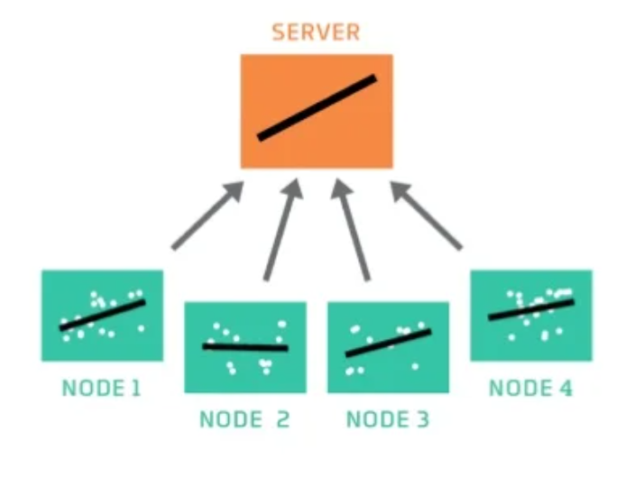
How Federated Learning works?
Each Node sends results back to the server.

Slide 21
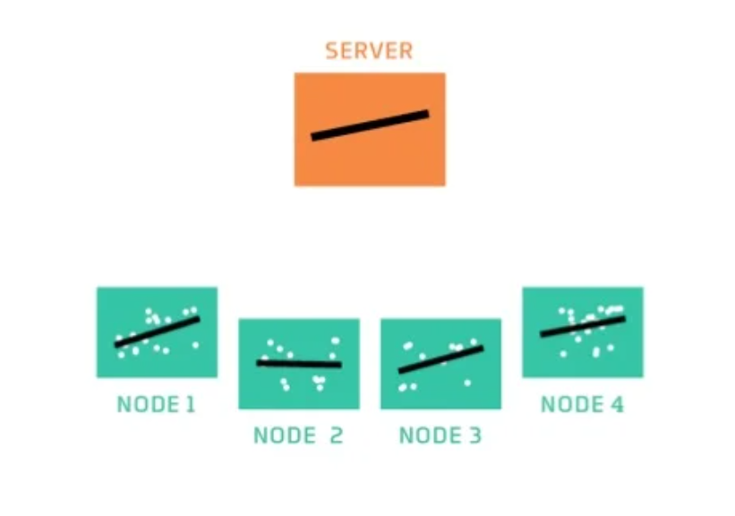
How Federated Learning works?
The server combines the models by taking an average.

Slide 22
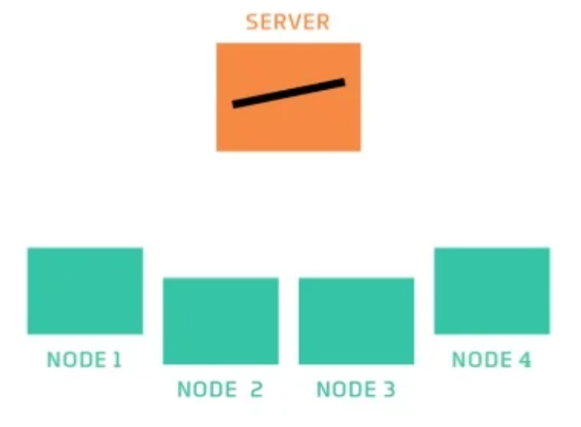
How Federated Learning works?
The server now has a model that can recognize patterns and after each communication round the connection is invoked..

Slide 23
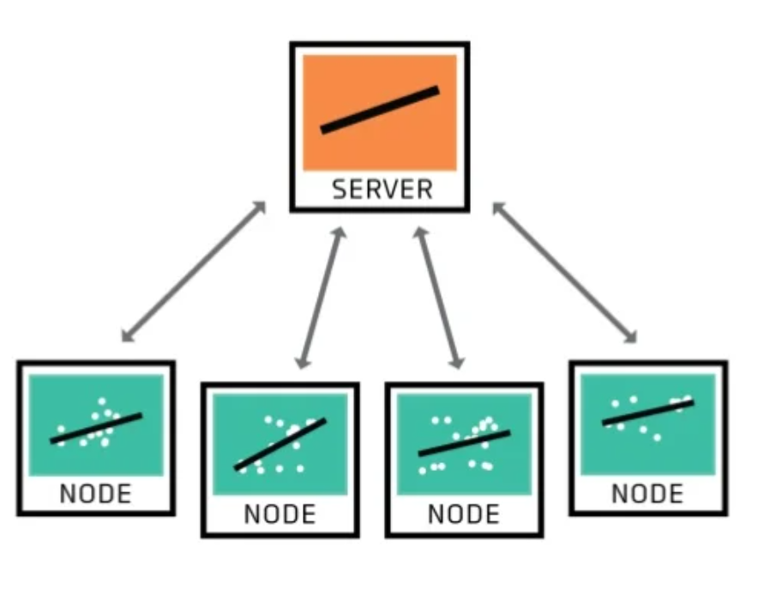
How Federated Learning works?
A network of Nodes share the training results rather than actual data.. This is How Federated Learning preserves Privacy

Slide 24
Federated Learning Algorithm(FedAvg)
4

Slide 25
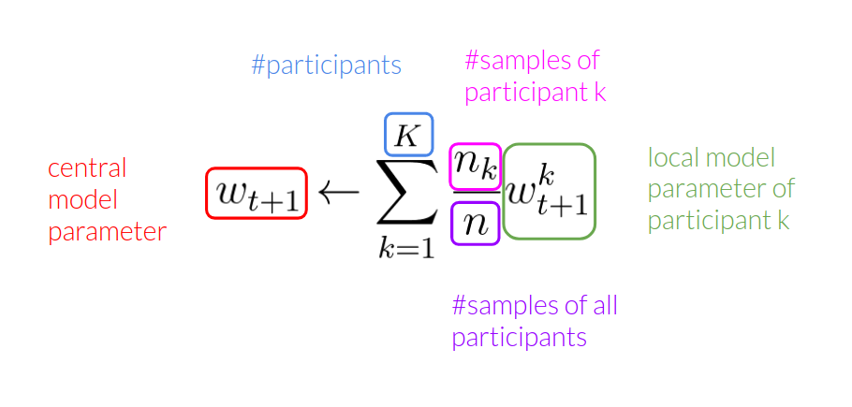
Federated avg learning Algorithm

Slide 26
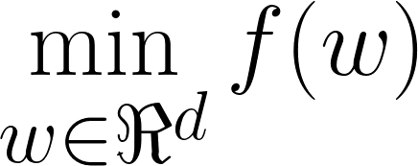
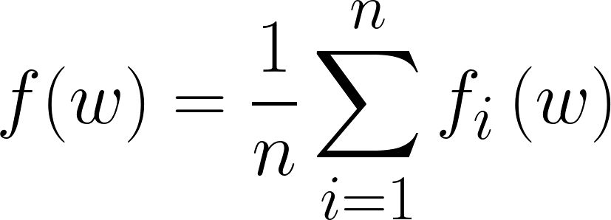
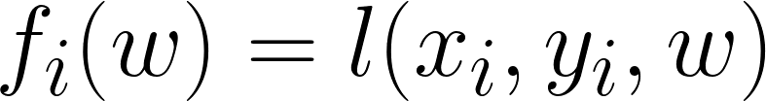
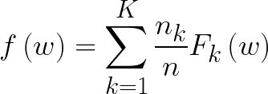
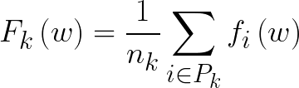
Deep learning model training:
Traditional | Federated
For a training dataset containing n samples (x_{i}, y_{i} ), 1 ≤ i ≤ n, the training objective is: where, is the loss of the prediction on example (x_{i},y_{i}). Deep learning optimization relies on SGD and its variants, | Suppose n training samples are distributed to K clients, where P_{K} is the set of indices of data points on client k, and n_{k} = |P_{k}| . For training objective: where,

Slide 27
So, what are its advantages?
5

Slide 28
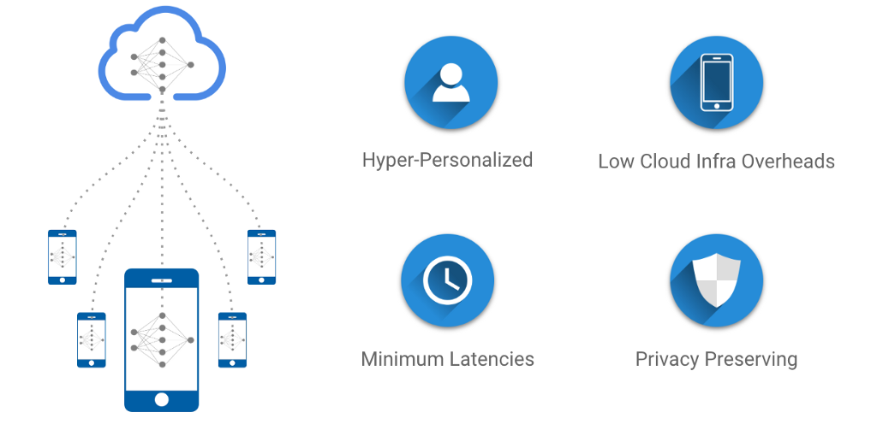
Advantage of Federated Learning
Smarter models
Less power consumption
Ensuring privacy

Slide 29
Our Implementation:
(Handwritten math equation recognizer)
6

Slide 30
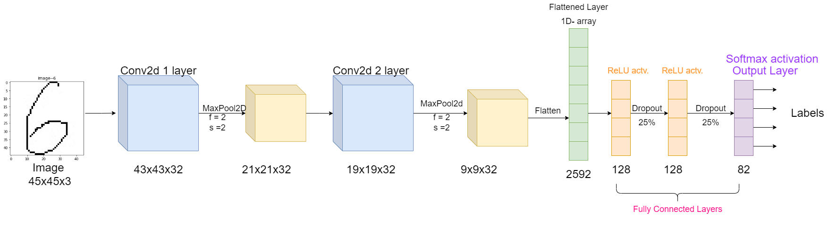
Server and Local CNN Architecture

Slide 31
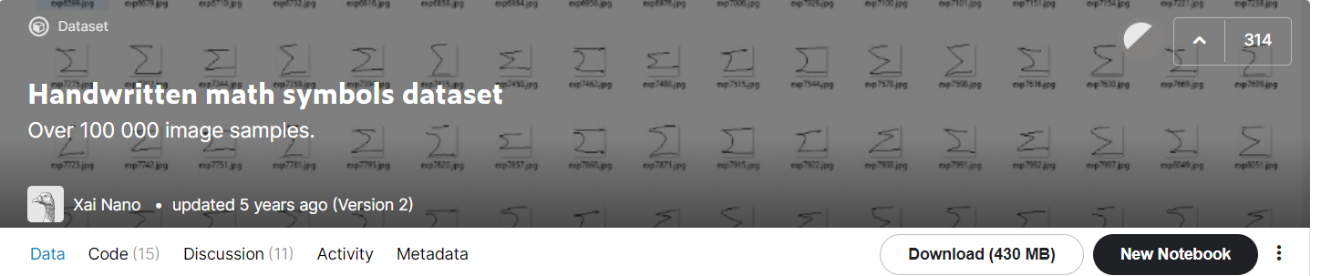
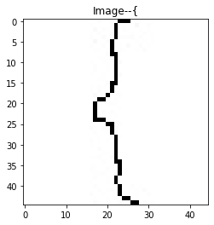
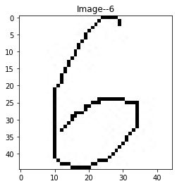
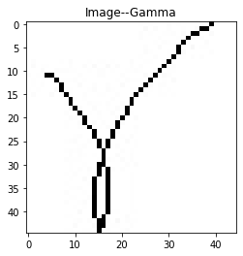
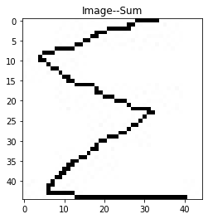
Image Dataset Used

Slide 32
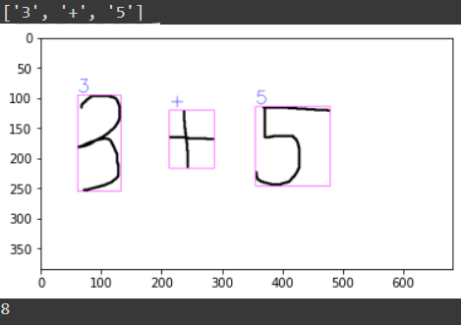
Predicted Output

Slide 33
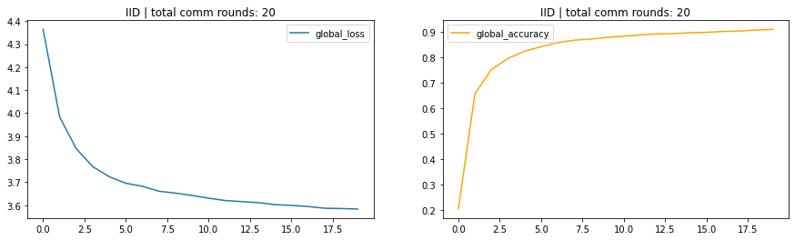
Global loss & accuracy (IID) , Accuracy peaks to 90%
IID(Identical and Independent Distribution)

Slide 34
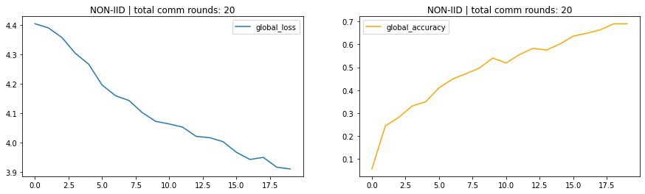
Global loss & accuracy (Non-IID) , Accuracy is about 70%
Non IID(Non-Identical and Independent Distribution)

Slide 35
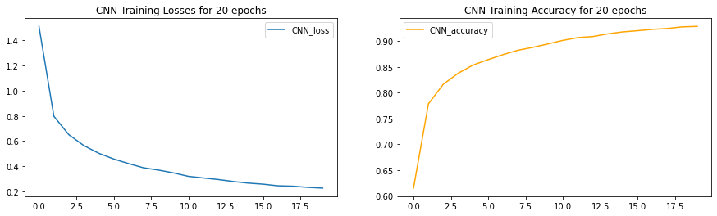
While Training only on CNN for 20 epochs ,accuracy peaked to 92.85%

Slide 36
Thank You

